Slide 1

CAPSTONE PROJECT E–Commerce Customer Data Analysis
Name: Alen Philip
Batch ID: WS103772

Slide 2
CONTENTS :
Objective
Exploratory Data Analysis & Data Visualization
Machine Learning
Conclusion

Slide 3
OBJECTIVE :
Enhancing Delivery Efficiency and Customer Satisfaction
The objective of this presentation is to explore the insights gained from our data analysis and machine learning models to identify key opportunities for enhancing delivery efficiency and customer satisfaction.

Slide 4

EXPLORATORY DATA ANALYSIS & DATA VISUALIZATION

Slide 5
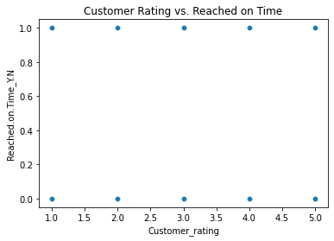
CUSTOMER RATING VS REACHED ON TIME :
Scatter Plot :
Positive correlation between customer rating and reached on time.
Customers value on-time delivery and are more likely to rate highly when orders are delivered punctually.
Some variation exists, indicating room for further improvements.

Slide 6
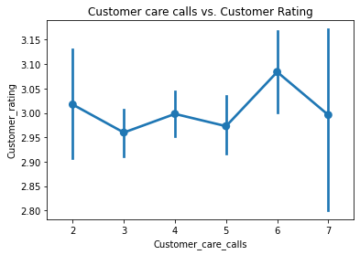
CUSTOMER CARE CALLS VS CUSTOMER RATING :
Point Plot:
Negative correlation between customer care calls and customer rating.
More calls result in lower customer satisfaction.
Must focus on reducing customer care calls by enhancing customer service.

Slide 7
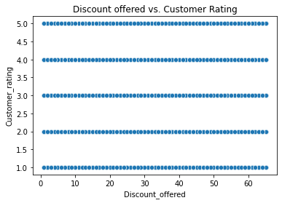
DISCOUNT OFFERED VS CUSTOMER RATING :
Scatter Plot:
Positive correlation between discount offered and customer rating.
Products with discounts are more likely to receive higher customer ratings.
Discounts play a significant role in influencing customer perception.

Slide 8
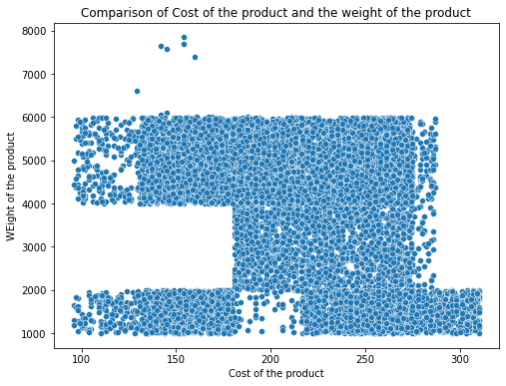
PRODUCT COST AND PRODUCT WEIGHT :
Positive correlation between the cost of the product and the weight of the product.
Products that are more expensive are also heavier.
There are also a few products that are relatively inexpensive but quite heavy.

Slide 9
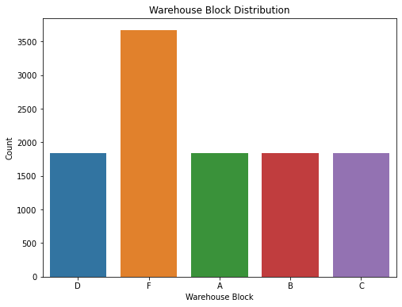
WAREHOUSE ANALYSIS :
Warehouse F is the busiest with the highest shipments and orders.

Slide 10
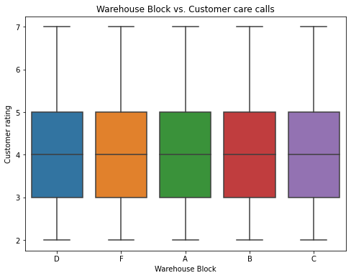
WAREHOUSE ANALYSIS :
Warehouse F also has the highest number of customer care calls, indicating potential issues with customer service.
Investigate and improve customer service in Warehouse F to reduce complaints.

Slide 11
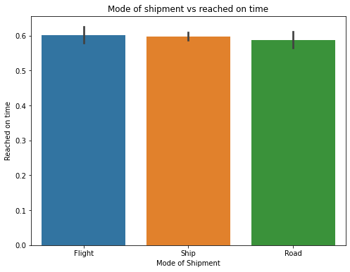
MODE OF SHIPMENT ANALYSIS :
Air shipments are the most reliable, followed by Sea shipments, while Road shipments have the lowest on-time delivery rates.
Improve ground and sea shipment processes to enhance delivery efficiency.
Air shipments can be further promoted for faster and more reliable delivery.

Slide 12
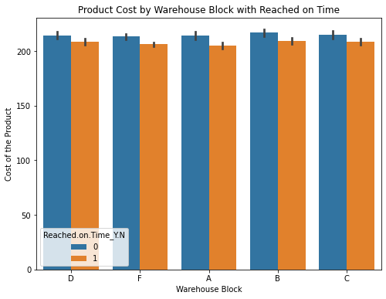
PRODUCT CHARACTERISTICS :
Positive correlation between product cost and Warehouse with reached on time.
More expensive products are more likely to be delivered on time.
High-cost products are crucial to customer satisfaction; ensure their timely delivery.

Slide 13
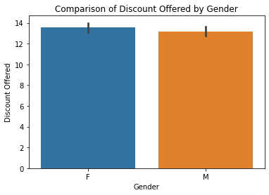
GENDER AND DISCOUNT OFFERED :
The company offers higher discounts to women than men, indicating potential gender bias.
Review discount policies to ensure fairness and equal treatment of all customers.

Slide 14

MACHINE LEARNING

Slide 15

MACHINE LEARNING :
After preprocessing the data, we applied three machine learning algorithms to predict whether a shipment would reach on time or not.
Model Performance :
Logistic Regression:
Accuracy: 65.27%
Decision Tree:
Accuracy: 64.77%
Random Forest:
Accuracy: 68.05%

Slide 16
MACHINE LEARNING :
Insights:
Random Forest achieved the highest accuracy among the three models.
Machine learning models show potential in predicting on-time deliveries.
Model Evaluation:
Accuracy as the primary metric provides a general overview of model performance.
For a more comprehensive analysis, consider other evaluation metrics such as precision, recall, and F1-score.

Slide 17
MACHINE LEARNING :
Actionable Steps:
Utilize the Random Forest model for predicting on-time deliveries based on the highest accuracy achieved.
Monitor and fine-tune the model periodically to ensure its effectiveness.
Implement the model in real-time to assist with delivery scheduling and resource allocation.

Slide 18

CONCLUSION

Slide 19
CONCLUSION :
Through Exploratory Data Analysis (EDA), we gained valuable insights into customer satisfaction and delivery efficiency.
Positive correlations between customer rating and on-time delivery, as well as between discounts offered and customer rating, highlight the significance of timely deliveries and discounts in influencing customer perception.
Understanding the relationship between product characteristics and delivery efficiency can help optimize the delivery process.
Additionally, EDA revealed the importance of reducing customer care calls and improving delivery efficiency for ground and sea shipments.

Slide 20
CONCLUSION :
The application of machine learning models further enhanced our understanding of delivery predictions.
The Random Forest model achieved the highest accuracy of 68.54% in predicting on-time deliveries.
It outperformed both the Logistic Regression and Decision Tree models.

Slide 21
CONCLUSION :
Combining EDA and machine learning, we have identified actionable steps to enhance overall delivery performance and customer satisfaction:
Utilize the Random Forest model to predict on-time deliveries and allocate resources effectively.
Implement strategies to reduce customer care calls and enhance customer service in Warehouse F.
Optimize discount policies for fair treatment of all customers.
Monitor and fine-tune the models regularly to maintain their effectiveness.
By implementing these recommendations, we can strengthen our delivery processes, foster customer loyalty, and drive success in our business operations

Slide 22
THANK YOU
Name: Alen Philip
Batch ID: WS103772

